Slide 1
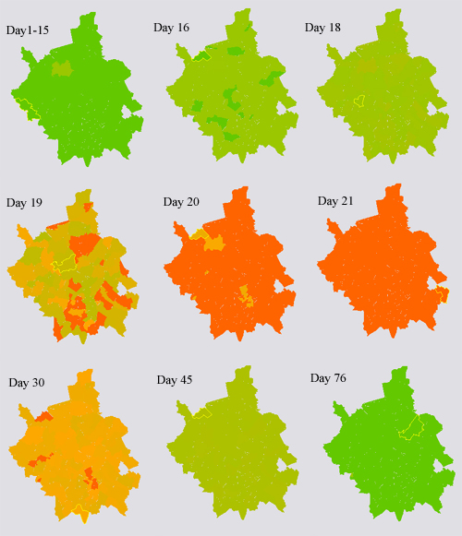
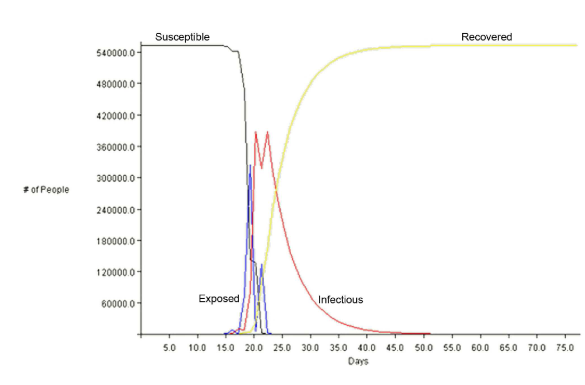
Epidemic Spreading
Parameters:
External Model based on population density and travel statistics

Slide 2
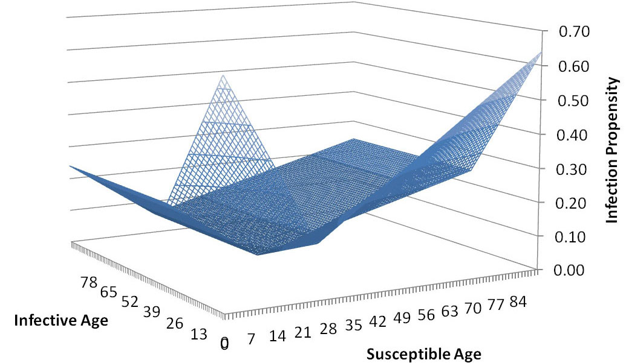
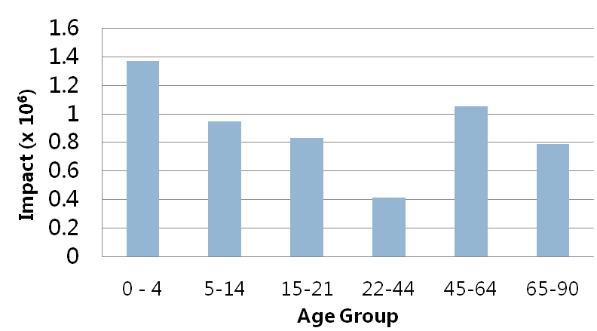
Age Dependency

Slide 3
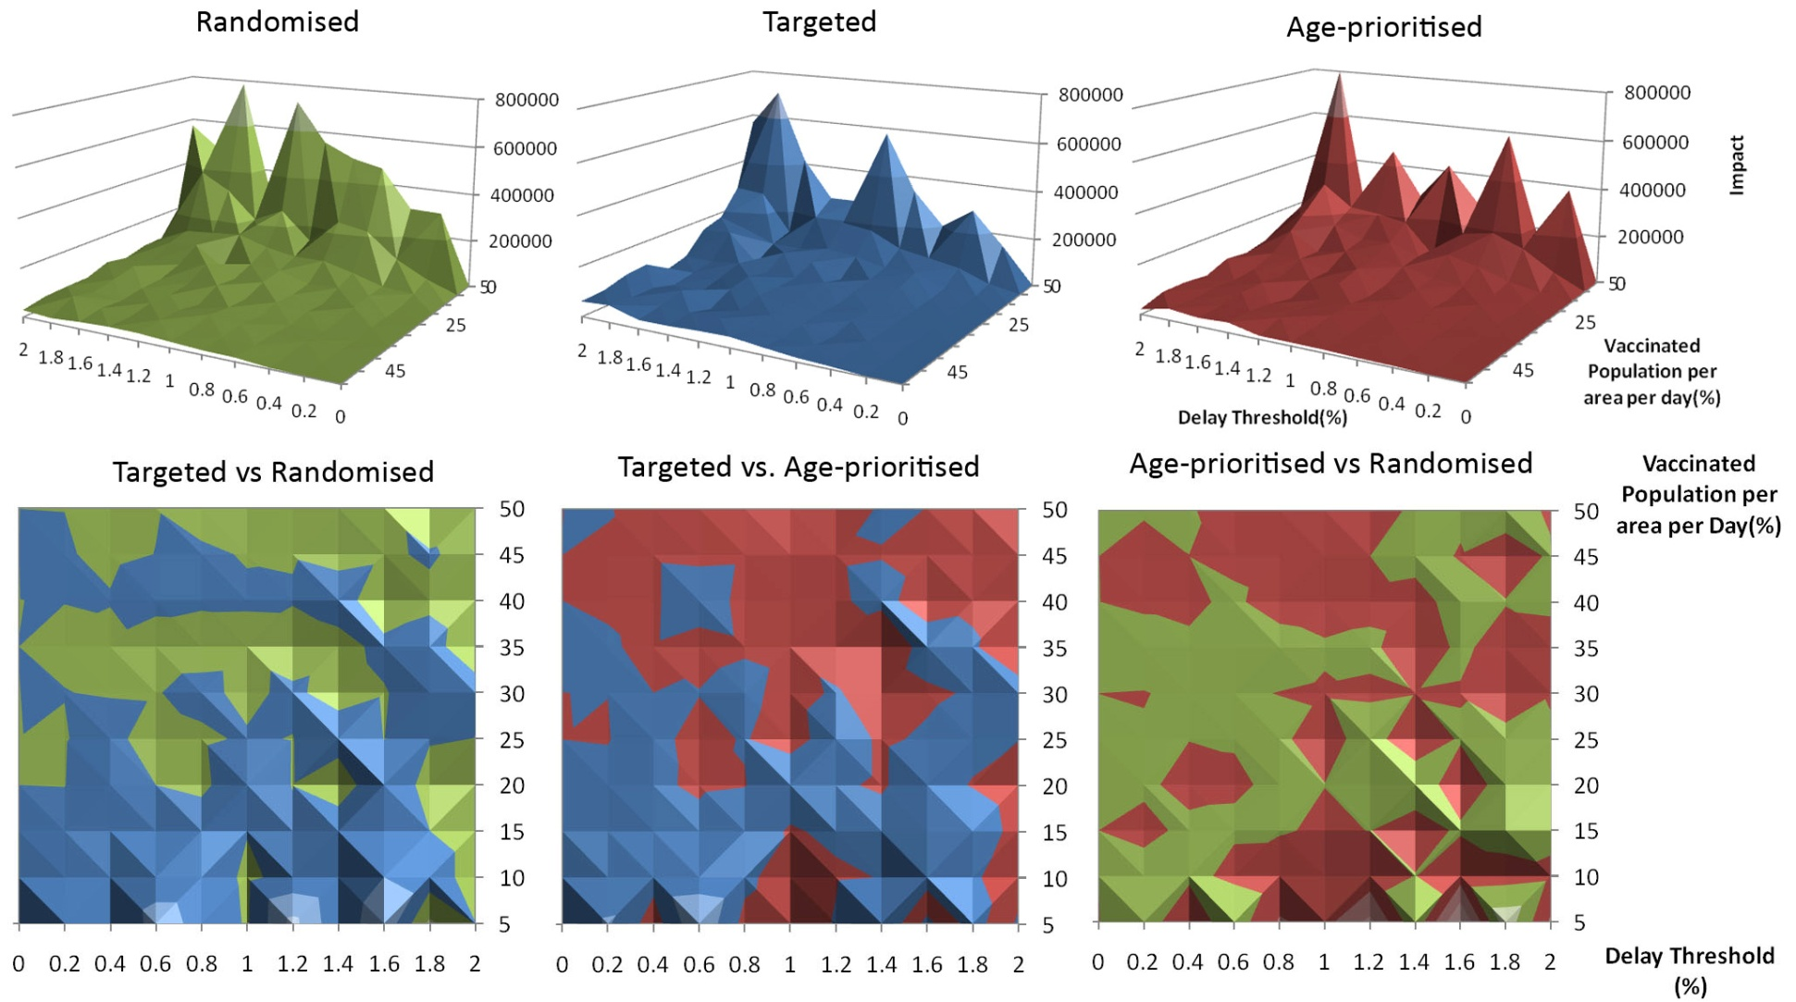
Vaccination Strategies

Slide 4
Future Work
More realistic Contact Network
  Time/Age dependency
  Human Dynamics/Mobility Model
  Probabilities for infection
  Network Parameters
  Non Co-location Infection
  Demographical Information
Social Containment Policies
Travel Patterns
Death/Birth Rate

Slide 5
Complex Networks
Community Detection in Large Networks
  Static Social Networks
  Time Dependent/Dynamic Networks
Novel Network Characteristics
  Recurrence Plots
Novel Network Models
  Time dependent networks

Slide 6
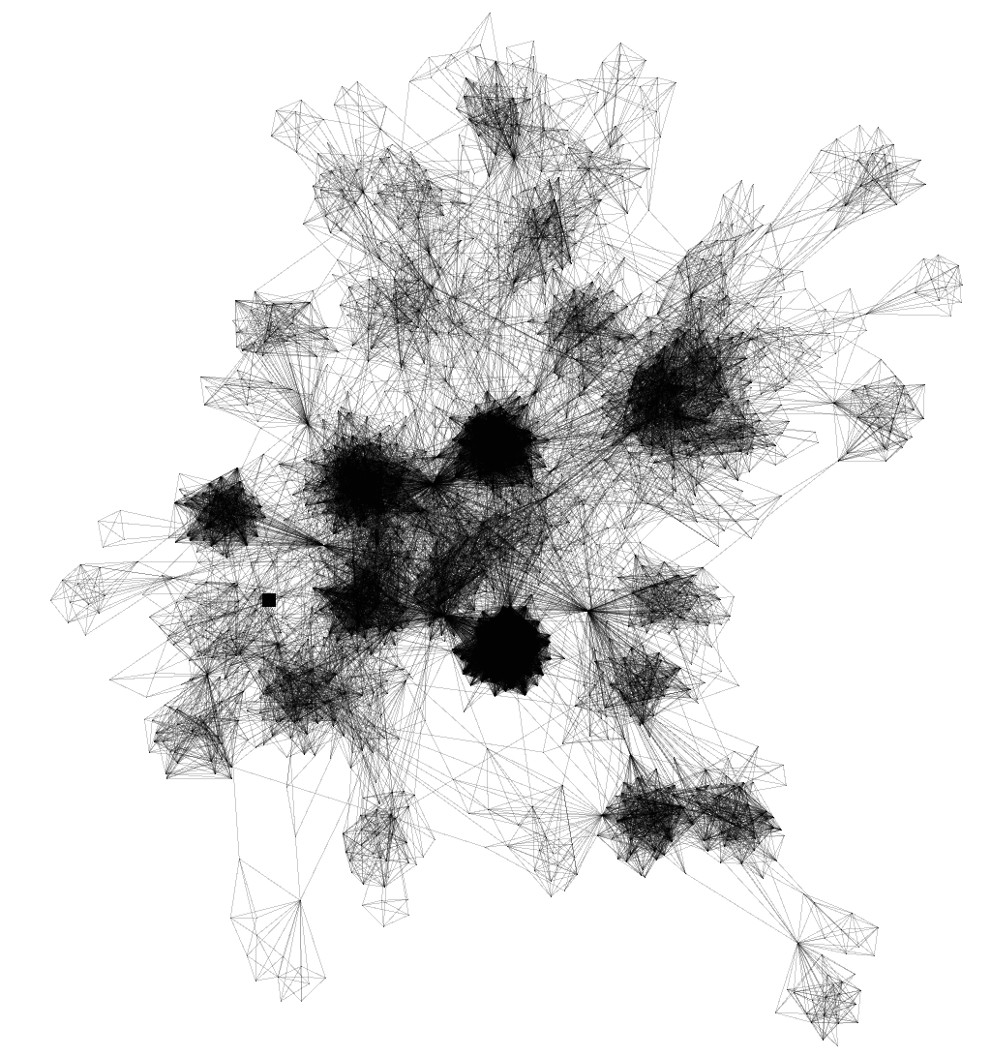
Community Detection in Large Social Networks
Orkut Online Social Network (3M nodes, 0.2B edges)(Mislove et. Al.)
Largest available network (1B edges)
Traditional Modularity-optimization approach is slow
Aim : Real-time
  Linear
  Accurate
  Distributed

Slide 7
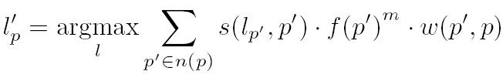
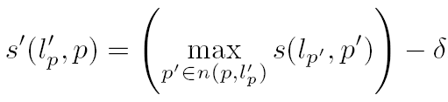
Real Time Community Detection (in submission to PRE)
Label Propagation (Nandini, Albert et. Al.)
Generalisation:
1
2
2
2
2
2
3
4
3
4
2
2

Slide 8
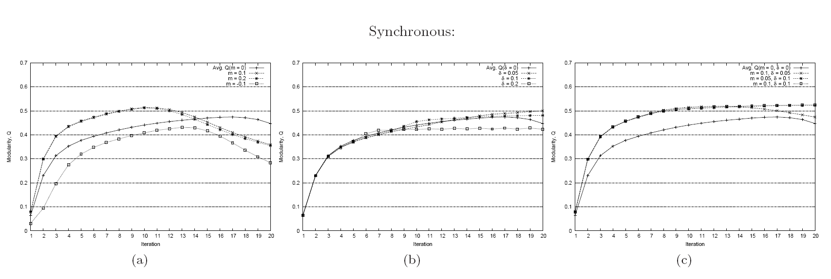
Real Time Community Detection
Asynchronous v. Synchronous
m, Label Preference
∂, Hop Attenuation

Slide 9
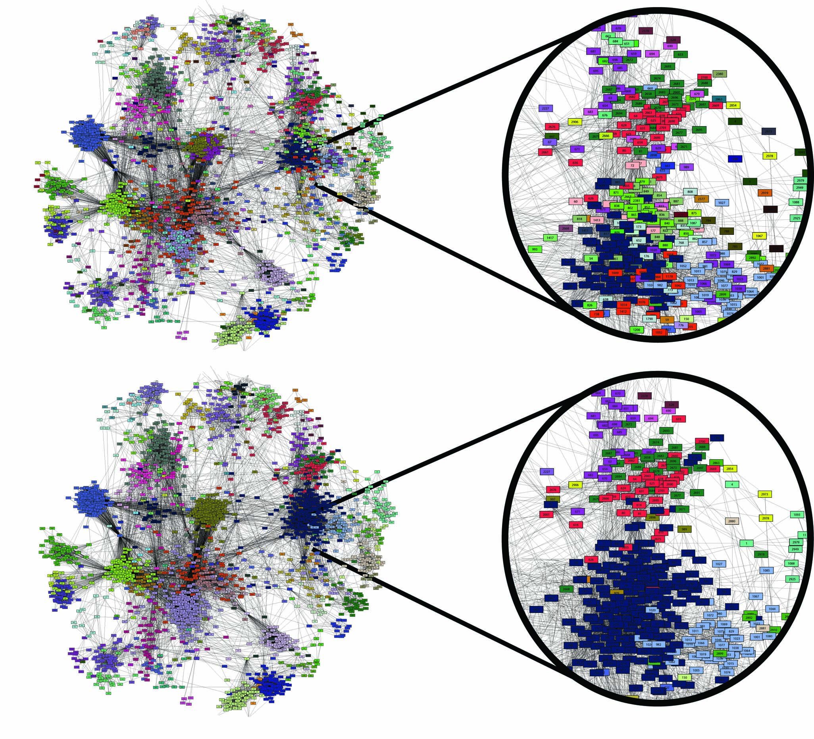
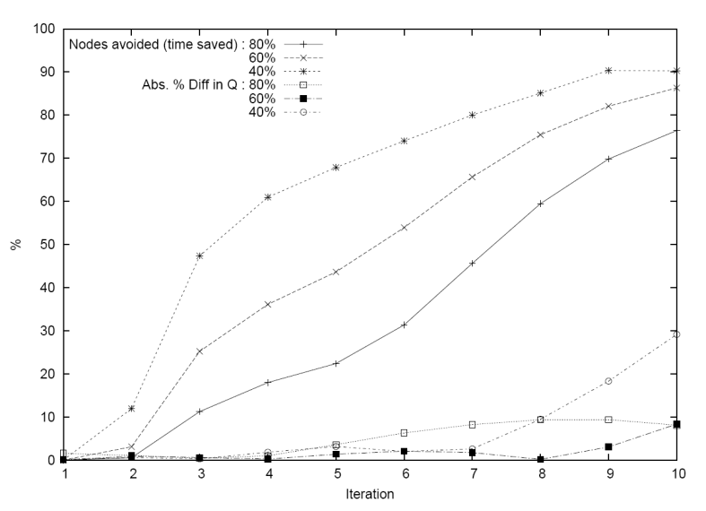
Real Time Community Detection
Linear Running Time (almost) – O(|E|)
Accurate
  5% within state of the art
Adaptive
Exploitable:
  Localised Metric – Easily Parallelised
  Avoid updating nodes well inside the community

Slide 10
Future Work
Static Network (OSN, Amazon, Google...relatively speaking) can be boring
Mostly done offline
Community Detection in Dynamic Networks in Real-Time
Idea: Consider moving spin glasses
Can apply a similar paradigm as the basis for the detection
More realistic mobility model

Slide 11
Summary
Altruism in Opportunistic Communication
Contact Network Modeling of Epidemics
Real-Time Community Detection in Large Networks
...

Slide 12
Thank You!

